Slide 1


About Altaviana
Hospital Readmissions for Diabetic Patients: A Predictive Modeling Approach
A private venture capital firm founded in 2011
Presentations are communication tools that can be used as demonstrations, lectures, speeches, reports, and more. It is mostly presented before an audience. It serves a variety of purposes, making presentations powerful tools for convincing and teaching.
Presentations are communication tools that can be used as demonstrations, lectures, speeches, reports, and more. It is mostly presented before an audience. It serves a variety of purposes, making presentations powerful tools for convincing and teaching.
Group 14:
Darsh Pinal Jogani, Shally Preethika Mani, Thriksha Giriraju, Zeeshan Ahmad
BUAN 6356.006

Slide 2


INTRODUCTION
To analyze the Diabetes Data from 130 US Hospitals (1999–2008), comprising 101,766 patient records with 47 attributes (7 numerical, 40 categorical), and leverage advanced data mining techniques to:
Uncover Patterns: Use Predictive models to identify relationships between diagnoses (diag_1, diag_2, diag_3), readmission rates, and diabetes treatments.
2. Predict Outcomes: Use Logistic regression and random forest to forecast readmissions and optimize treatment plans for improved healthcare delivery.

Slide 3
Objective
The Challenge
Healthcare providers face rising costs, evolving patient needs, and regulatory demands, with much of the vast data from EHRs and clinical trials remaining underutilized.
The Opportunity
Advanced analytics can transform raw data into actionable insights, improving diabetic patient outcomes, reducing their readmissions, and optimizing resources.
Our Approach
Using diabetes data from 130 hospitals, we apply Data Selection, Data Pre-Processing, Exploratory data analysis and predictive modeling to enable:
Personalized care.
Better resource allocation.
Proactive disease management.
Goal: Drive efficient, patient-centered healthcare through data-driven solutions.

Slide 4

Data Description
Dataset: Diabetes 130-US hospitals dataset (1999–2008)
Key Features: Patient demographics, admission details, medical information, visit history
Target Variable: Readmission status within 30 days
Focus: Predicting early readmissions to improve care quality.
01
05

Slide 5
Methodology
Data selection: Identifying and preparing the data for Analysis
Data Cleaning: Addressed missing values and ensured consistency.
Data Preprocessing: Transformed and filtered data for analysis.
Modeling: Built Random Forest and Logistic Regression models.
Plotting and Analysis: Summarized results to achieve accuracy insights for business applications.

Slide 6
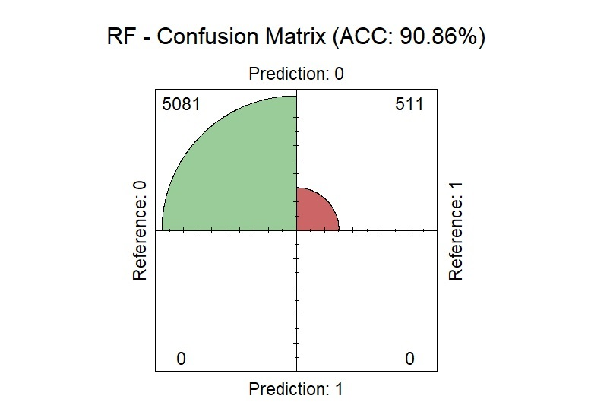

Analysis and Results
Accuracy: Both models performed similarly in terms of overall accuracy, with Random Forest slightly outperforming Logistic Regression (90.86% vs 90.72%).
Sensitivity: Random Forest achieved perfect sensitivity (1.00), meaning it correctly identified all positive cases (patients who were readmitted). Logistic Regression was also highly sensitive (0.9982).
01
05

Slide 7
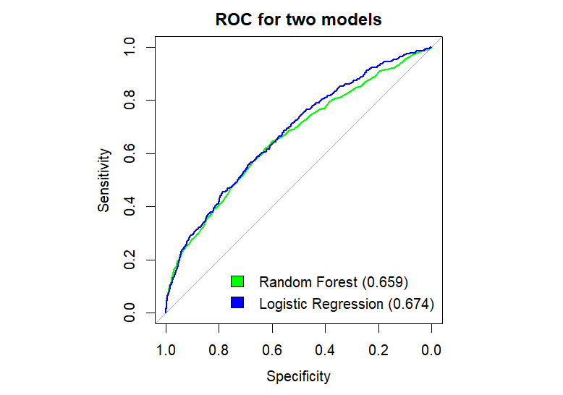
Analysis and Results
AUC (Area Under the Curve): Logistic Regression had a slightly higher AUC (0.674) compared to Random Forest (0.659), indicating a marginally better overall discriminative ability.
ROC Curves: The ROC curves for both models were plotted, visually confirming the similar performance with a slight edge for Logistic Regression.
01
05

Slide 8
Business Recommendations
1. Integration of Predictive Models into Healthcare Systems
Implement the Random Forest and Logistic Regression models in the hospital's electronic health record (EHR) system.
Use the models to flag high-risk diabetic patients for closer monitoring and personalized interventions.
2. Develop Targeted Care Plans
Focus on key predictors like age, race, admission type, A1C levels, and medication changes to design individualized care strategies.
Provide additional education and support for high-risk patients during discharge to prevent readmissions.
3. Enhanced Discharge Planning
Develop comprehensive discharge plans for diabetic patients, including clear instructions on medication, diet, and follow-up appointments.
Assign care coordinators to ensure high-risk patients adhere to their post-discharge care plan.
01
05

Slide 9
Business Recommendations
4. Regular Follow-up Programs
Schedule follow-up visits or telehealth consultations within the first 30 days post-discharge.
Use reminders or automated systems to check in with patients to address complications early.
5. Resource Optimization
Allocate resources such as specialized staff and equipment more effectively to address the needs of high-risk patients.
Focus hospital resources on areas with the highest likelihood of reducing readmission rates, such as diabetes education and better glycemic control.
6. Data-Driven Policy Updates
Regularly update hospital policies using insights from predictive analytics to improve outcomes.
Continuously refine predictive models with new data to maintain accuracy and relevance
01
05

Slide 10
Thank you

